Slide 1
Bootstrap

Slide 2

Bootstrap
Bootstrap is a free front-end framework for faster and easier web development
It includes HTML and CSS based design templates for typography, forms, buttons, tables, navigation, modals, image carousels and many other, as well as optional JavaScript plugins
It also gives you the ability to easily create responsive designs

Slide 3
Versions
Bootstrap 5 (released 2021) is the newest version of Bootstrap (released 2013.
The main differences between Bootstrap 5 and Bootstrap 3 & 4, is that Bootstrap 5 has switched to vanilla JavaScript instead of jQuery.

Slide 4
Advantages of Bootstrap
Easy to use: Anybody with just basic knowledge of HTML and CSS can start using Bootstrap
Responsive features: Bootstrap's responsive CSS adjusts to phones, tablets, and desktops
Mobile-first approach: In Bootstrap, mobile-first styles are part of the core framework
Browser compatibility: Bootstrap 5 is compatible with all modern browsers (Chrome, Firefox, Edge, Safari, and Opera). Note that if you need support for IE11 and down, you must use either BS4 or BS3.

Slide 5
Where to Get Bootstrap 5?
There are two ways to start using Bootstrap 5 on your own web site.
Include Bootstrap 5 from a CDN (Content Delivery Network).
Download Bootstrap 5 from getbootstrap.com

Slide 6
Using Bootstrap CDN
When you only need to include Bootstrap’s compiled CSS or JS, you can use jsDelivr.
CSS - Copy-paste the stylesheet <link> into your <head> before all other stylesheets to load our CSS.
<!-- CSS only -->
<linkhref="https://cdn.jsdelivr.net/npm/bootstrap@5.2.0/dist/css/bootstrap.min.css" rel="stylesheet"integrity="sha384gH2yIJqKdNHPEq0n4Mqa/HGKIhSkIHeL5AyhkYV8i59U5AR6csBvApHHNl/vI1Bx" crossorigin="anonymous">

Slide 7
Using Bootstrap CDN
JS
Many of our components require the use of JavaScript to function. Specifically, they require our own JavaScript plugins and Popper. Place one of the following <script>s near the end of your pages, right before the closing </body> tag, to enable them.
<script src="https://cdn.jsdelivr.net/npm/bootstrap@5.0.2/dist/js/bootstrap.bundle.min.js" integrity="sha384-MrcW6ZMFYlzcLA8Nl+NtUVF0sA7MsXsP1UyJoMp4YLEuNSfAP+JcXn/tWtIaxVXM" crossorigin="anonymous"></script>

Slide 8
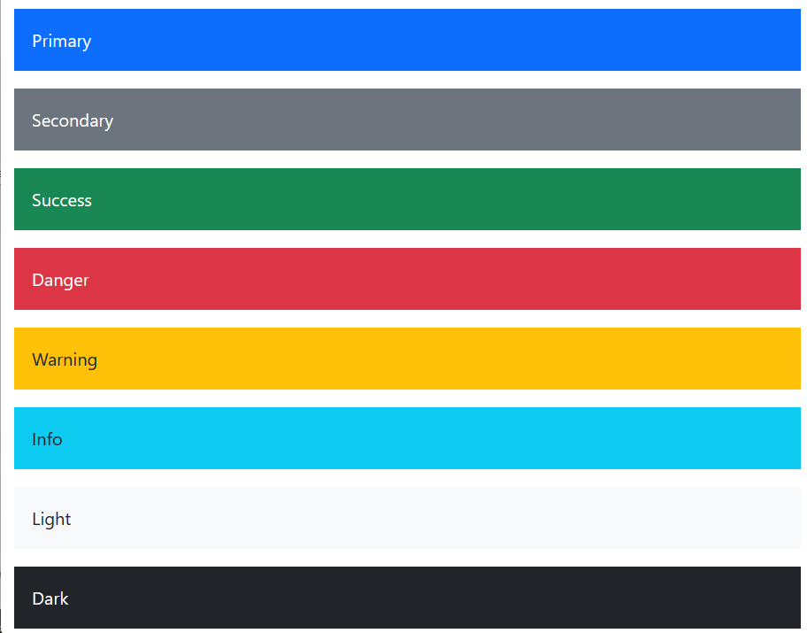
Color
Bootstrap is supported by an extensive color system that themes our styles and components. This enables more comprehensive customization and extension for any project.

Slide 9
Text Color
To use contextual classes for the font color, you should include the text class prefix in the beginning:
<p class="text-success">Success.</p>

Slide 10
Background Color
color the background instead of the characters themselves, you should use the bg class prefix:
<p class="bg-success">Success.</p>

Slide 11
Buttons
Bootstrap’s custom button styles for actions in forms, dialogs, and more with support for multiple sizes, states, and more.
<button type="button" class="btn btn-primary">Primary</button>
Outline buttons
<button type="button" class="btn btn-outline-primary">Primary</button>
Sizes - btn-lg | btn-sm |
<button type="button" class="btn btn-primary btn-lg">Large button</button>

Slide 12
Buttons
Activate/Disable Buttons
<button class="btn disabled" type="button">Disabled</button> <button class="btn active" type="button">Active</button> <a href="#" class="btn disabled">Disabled</a>

Slide 13
Containers
Containers are a fundamental building block of Bootstrap that contain, pad, and align your content within a given device or viewport.
Containers are the most basic layout element in Bootstrap and are required when using our default grid system.

Slide 14
Containers
Bootstrap comes with three different containers:
.container, which sets a max-width at each responsive breakpoint
.container-fluid, which is width: 100% at all breakpoints
.container-{breakpoint}, which is width: 100% until the specified breakpoint

Slide 15
Default container
default .container class is a responsive, fixed-width container, meaning its max-width changes at each breakpoint.
<div class="container">
<!-- Content here -->
</div>

Slide 16
Responsive containers
Responsive containers allow you to specify a class that is 100% wide until the specified breakpoint is reached, after which we apply max-widths for each of the higher breakpoints.
For example, .container-sm is 100% wide to start until the sm breakpoint is reached, where it will scale up with md, lg, xl, and xxl.
Eg:
<div class="container-sm">100% wide until small breakpoint</div>

Slide 17
Fluid containers
Use .container-fluid for a full width container, spanning the entire width of the viewport.
<div class="container-fluid">
...
</div>

Slide 18
Spacing
Bootstrap includes a wide range of shorthand responsive margin, padding, and gap utility classes to modify an element’s appearance.
m - for classes that set margin mt- mb- ms me
p - for classes that set padding

Slide 19
Where sides is one of:
t - for classes that set margin-top or padding-top
b - for classes that set margin-bottom or padding-bottom
s - (start) for classes that set margin-left or padding-left in LTR, margin-right or padding-right in RTL
e - (end) for classes that set margin-right or padding-right in LTR, margin-left or padding-left in RTL
x - for classes that set both *-left and *-right
y - for classes that set both *-top and *-bottom
blank - for classes that set a margin or padding on all 4 sides of the element

Slide 20
Where size is one of:
0 - for classes that eliminate the margin or padding by setting it to 0
1 - (by default) for classes that set the margin or padding to $spacer * .25
2 - (by default) for classes that set the margin or padding to $spacer * .5
3 - (by default) for classes that set the margin or padding to $spacer
4 - (by default) for classes that set the margin or padding to $spacer * 1.5
5 - (by default) for classes that set the margin or padding to $spacer * 3
auto - for classes that set the margin to auto

Slide 21
Borders
Use border utilities to quickly style the border and border-radius of an element. Great for images, buttons, or any other element.
<div class=" border"></div>
Border color
<div class="container border border-primary"></div>
Border-width (1 to 5)
<div class="container border border-primary border-4"></div>

Slide 22
TEXT
Text - color
<p class="text-primary">
Text alignment
Start align - class="text-start"
<p class="text-start">Start aligned text on all viewport sizes.</p>
Center align - class="text-center"
End Align - class="text-end"

Slide 23
Font size
As the number increases, their size decreases.
<p class="fs-1">text</p>
<p class="fs-2">text</p>
<p class="fs-3">text</p>
<p class="fs-4"> text</p>
<p class="fs-5">text</p>
<p class="fs-6">text</p>

Slide 24
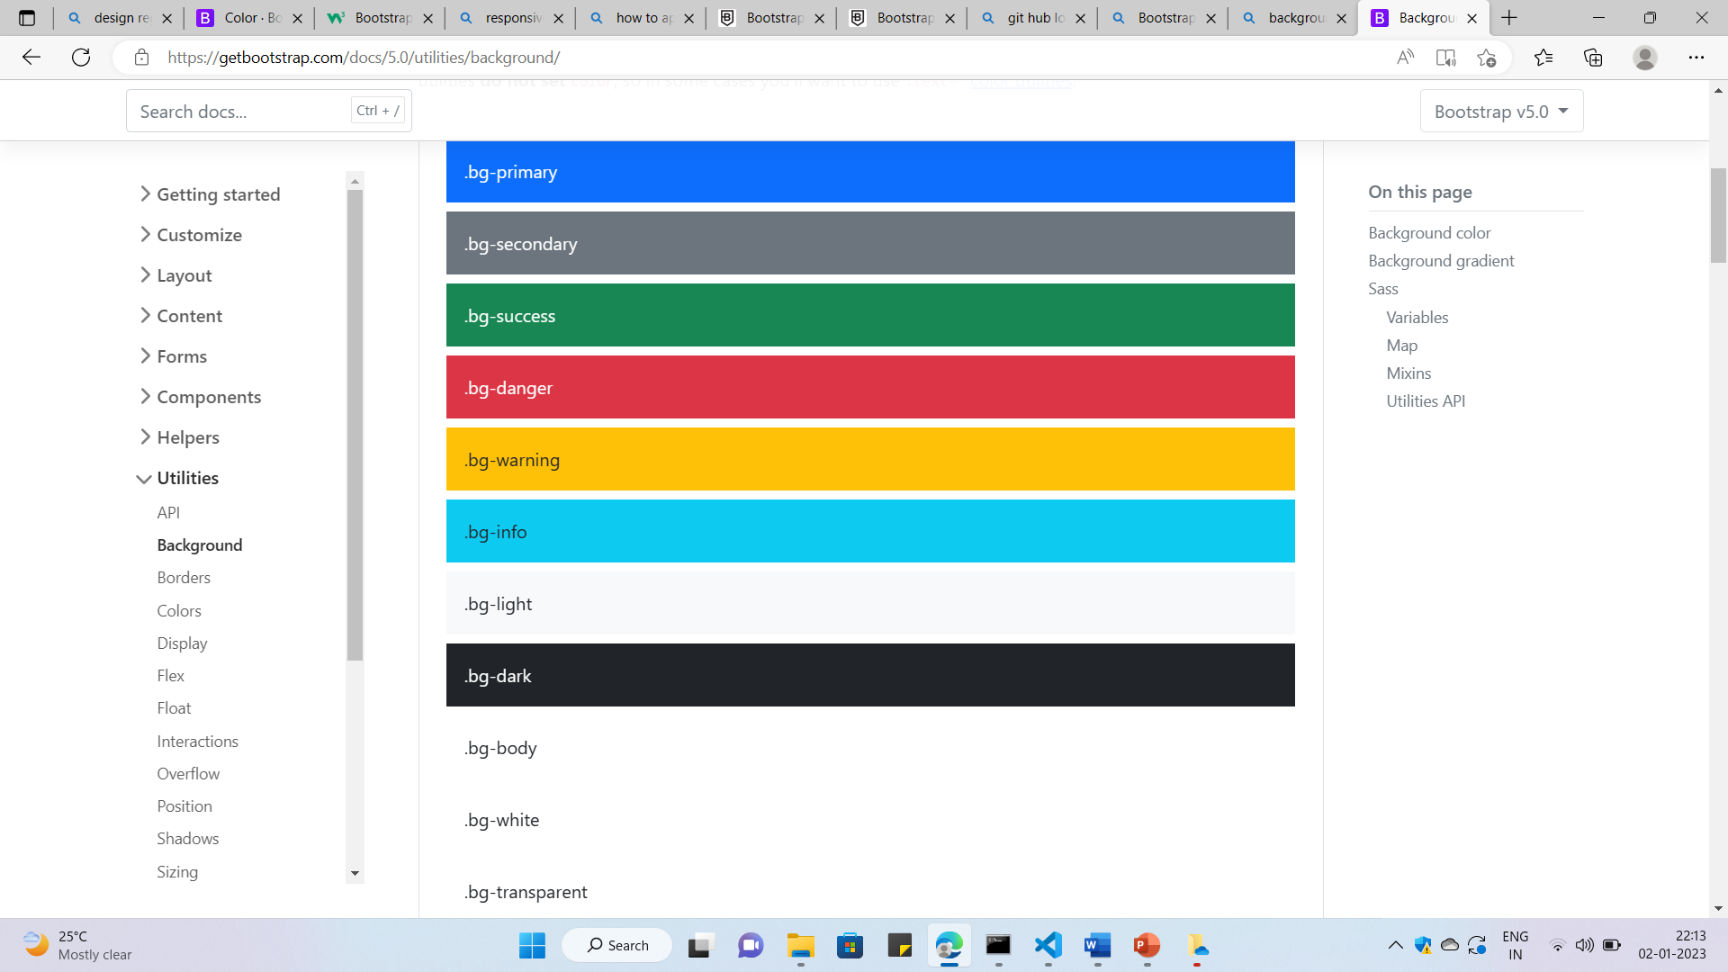
background color
<p class="bg-primary">

Slide 25
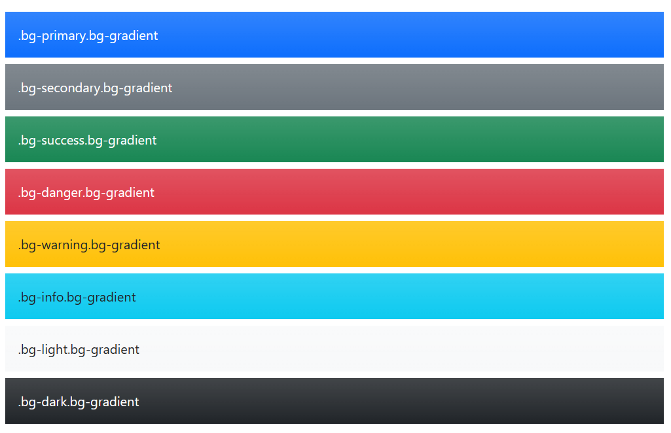
Background gradient
By adding a .bg-gradient class, a linear gradient is added as background image to the backgrounds. This gradient starts with a semi-transparent white which fades out to the bottom.

Slide 26
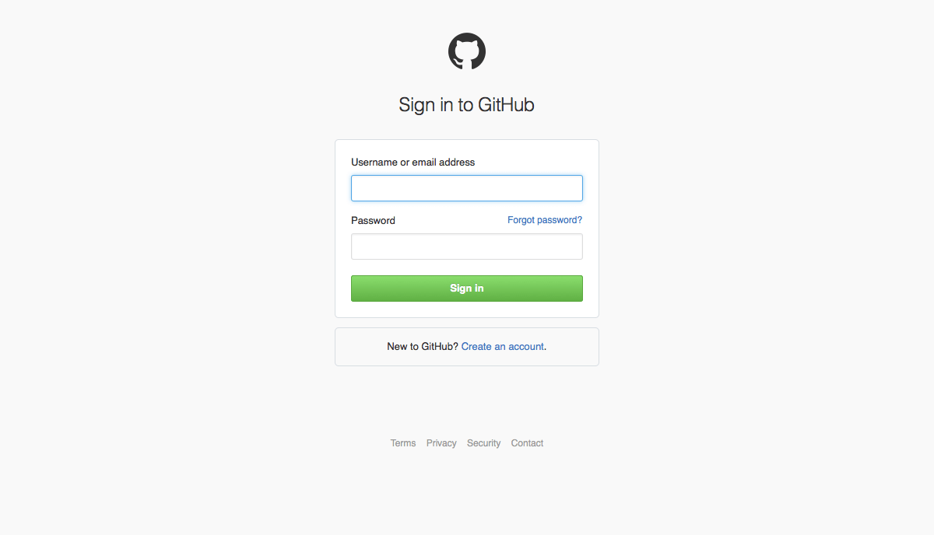
TASK

Slide 27
